Slide 1
BREAST CANCER PREDICTION

Slide 2

IMPLEMENTATION
Data is selected from the website ‘Kaggle’.
Data is collected and sorted.
Data is filtered.
Label encoder is used to normalize the labels.
We are plotting the count of the diagnosis column, the correlation graph and analyzing it.
Now, implementing the model and finding out the accuracy of different machine learning algorithms.
We got RandomForestClassifier as the best and accurate algorithm for the data with 92.61% accuracy score percentage.

Slide 3
METHODS
Used models: Logistic Regression, Random Forest, Decision Tree, and SVC.
We are doing the correlation and training the model to predict Breast cancer using different ML models
Many graphs are plotted for Correlation and the count of the diagnosis.
Cross validation scores of each model is done in this project.

Slide 4
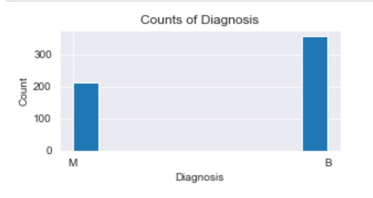
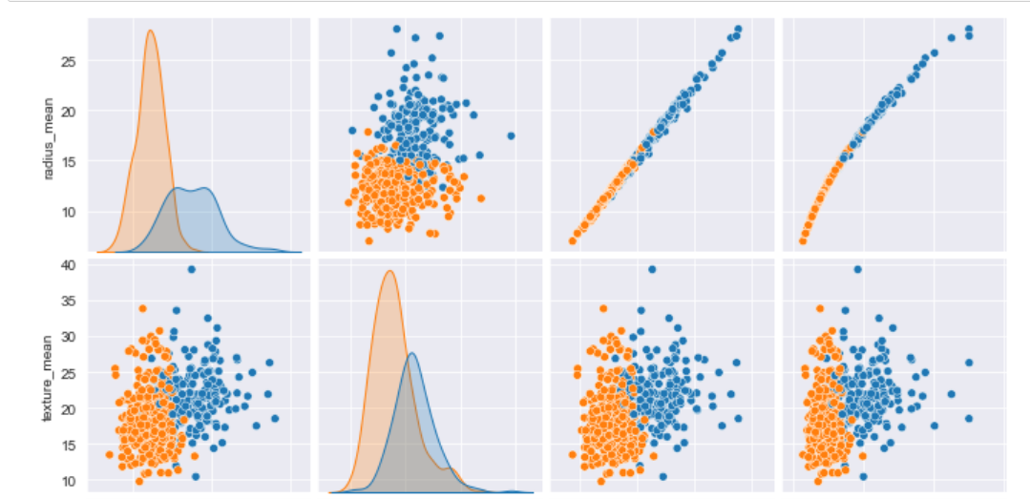
Visualisation
The figures below shows the correlation and count of Diagnosis.
M-212 B-357
The blue colour indicates the Diagnosis of Malignant and orange indicates the Diagnosis of Benign.

Slide 5
Results
we found that Random forest Classifier achieved a higher efficiency of 92.61%, Precision of 92%, f1-score of 93% and outperforms all other algorithms.
In conclusion, Random forest Classifier has demonstrated its efficiency in Breast Cancer prediction and diagnosis and achieves the best performance in terms of efficiency and precision.

Slide 6

THANK YOU

